Slide 1

Case Study 1 MSDS 6306
By: Jack Korbitz of DDSAnalytics

Slide 2




1.
3 biggest factors leading to voluntary attrition
2.
Department specific Trends
3.
Other interesting discoveries
z

Slide 3
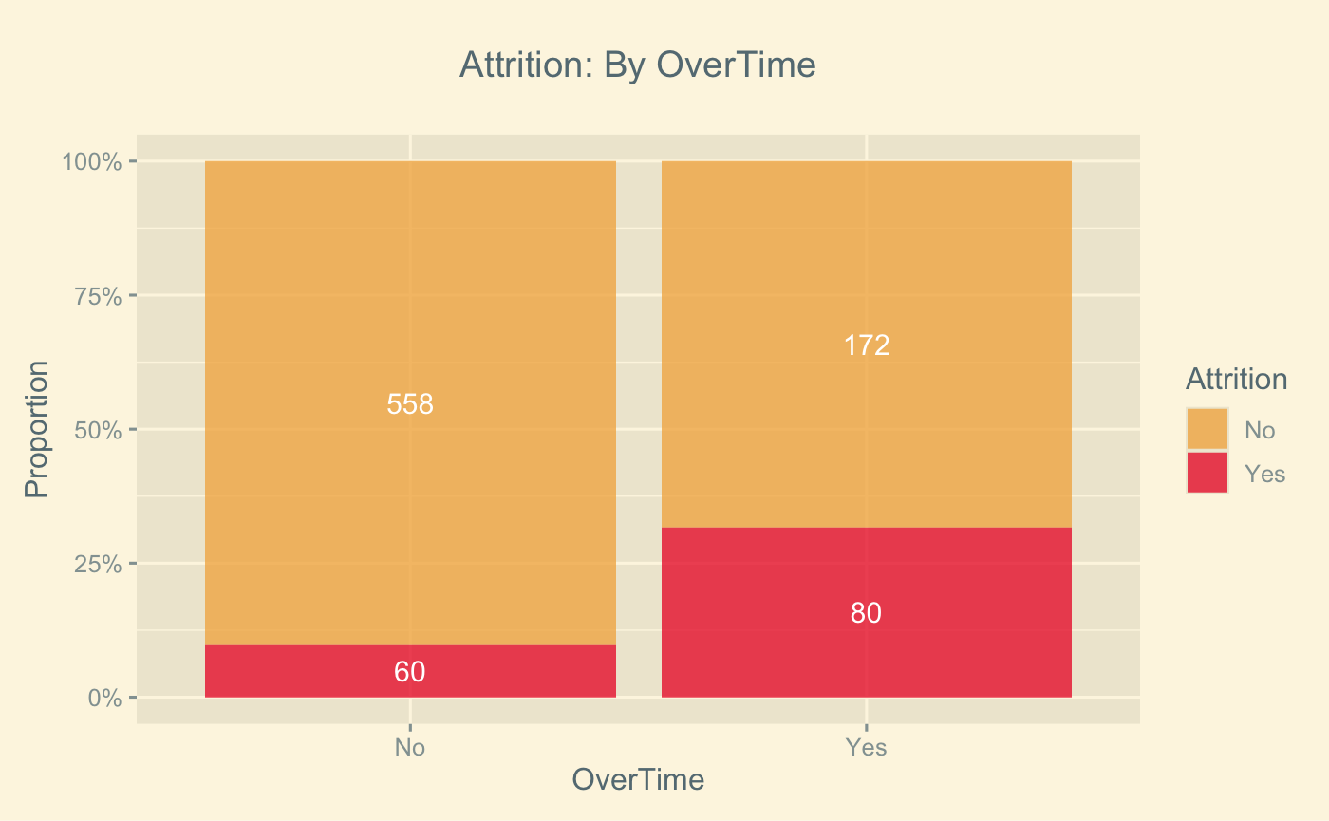
Factor 1: Overtime
Overtime
31.7% on overtime will leave
Non-Overtime
9.7% attrition
57.1% of all attrition

Slide 4
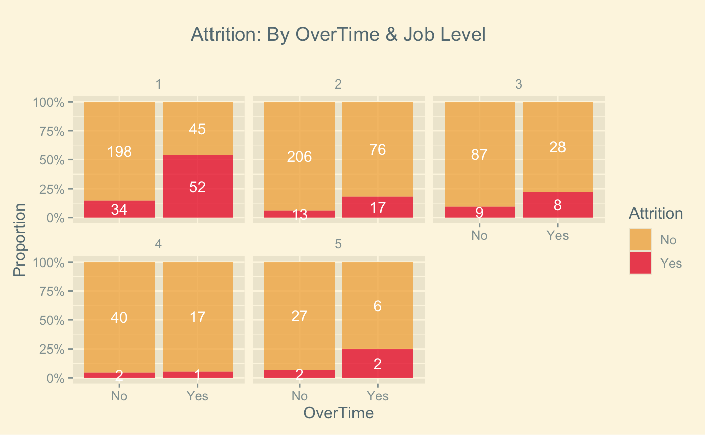
Factor 1: Overtime | Job Level
Job level 1:OT
53.6% attrition
Job Level 1: Non-OT
14.7% attrition
Job Level 1 statistics
~38% workforce
61.4% of all attrition

Slide 5
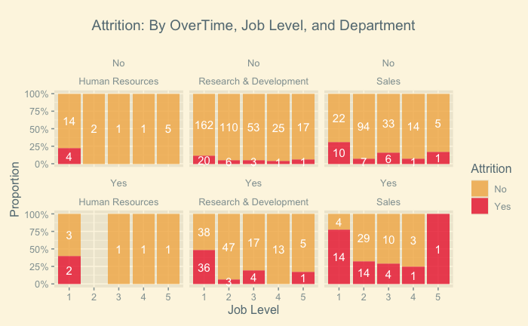
Factor 1: Overtime | Department

Slide 6
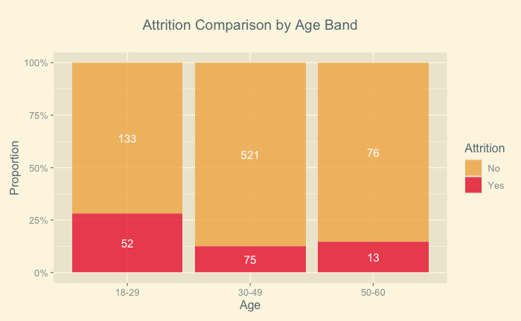
Factor 2: Younger professionals
Ages 18-29
28.1% attrition
Age 30-49
12.6% attrition

Slide 7
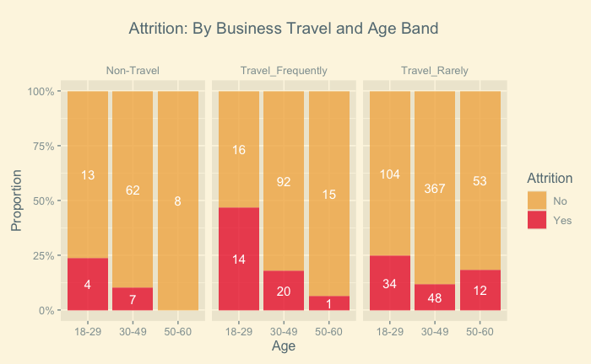
Factor 2: Young Professionals Who frequently travel
Ages 18 – 29
Frequent Travel
46.7% attrition

Slide 8
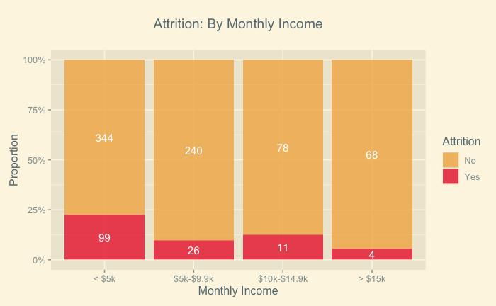
Factor 3: Monthly Income
Mean Incomes
$6,390
<$5,000
22.3% attrition
Current: $6,702
Former:$4,764

Slide 9
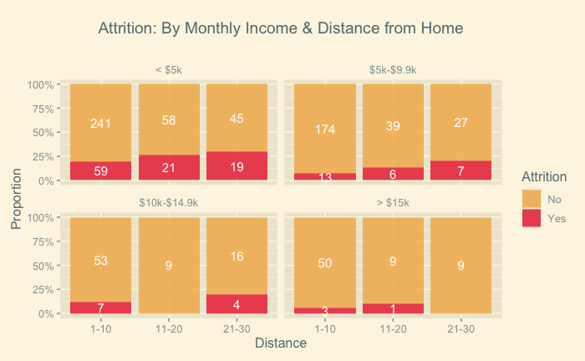
Factor 3: Monthly Income by Daily Travel

